Slide 1

Motivation
For most fitness beginners, they know very little knowledge about how to effectively gain muscle and lose fat.
A smart diet track app is very helpful for fitness beginners to track the calorie and nutrient intake they have for every meal
According to this research[1] by JMIR Health, People who used a fitness app are more motivated to exercise and maintain their diet if the results of the training they do and the calories they intake from their food can be physically seen through the app .

Slide 2
Objective of the project
The objective of this project is to design a mobile application which will allow people to track their caloric intake by inputting the name of the food, scanning a barcode or by simply taking a picture of what they eat.
We would be using artificial intelligence techniques for image and data processing to recognize the food from the image and public nutritional APIs to supply the number of calories and find recipes based on the name/type of food.

Slide 3
Design Advantage
Smart Diet Track is a leading fitness app that not only allows users to track their daily caloric intake and manage their meal prep according to the calories left for the day, but also able to conveniently provide nutrition information of the food taken.
The convenience specifically reflected in the feature that the users can either choose to manually scan the barcode of the food or use our AI camera that can automatically identify the calories of the food that's within the image. This functionality provides different user needs (such as a user having dinner in a restaurant that he can't tell how much calorie was taken)
The app also utilizes the nutrition intake calculator to accurately calculate specific nutrient information data of the food that will be fetched from Food Data Central API

Slide 4
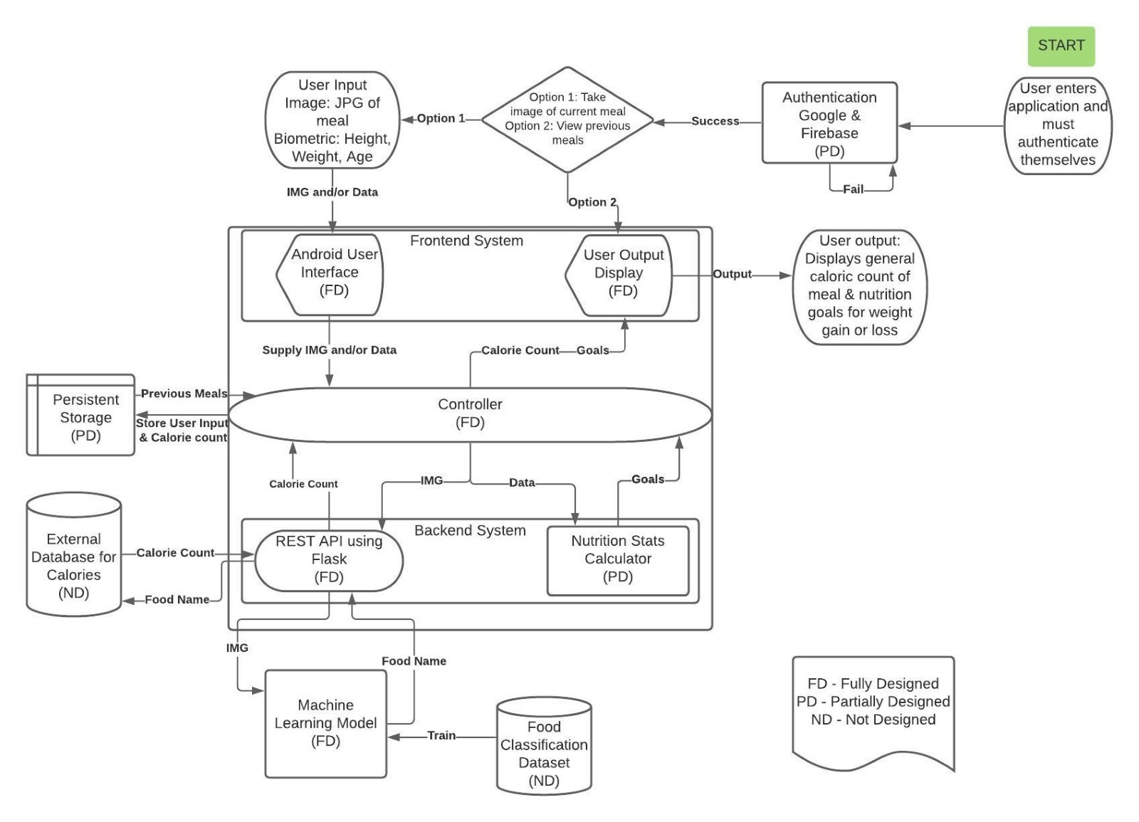
Block Diagram

Slide 5
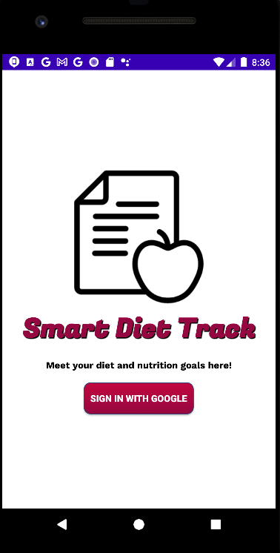
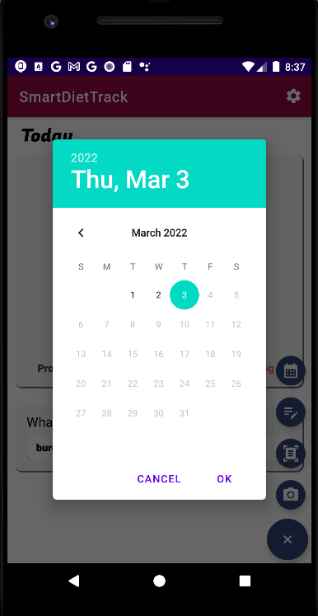
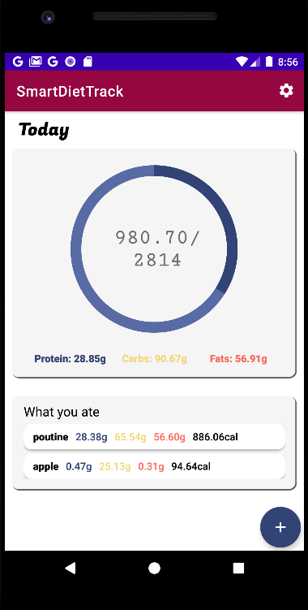
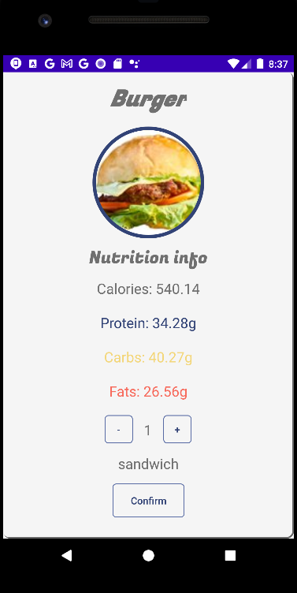
Front-end Design

Slide 6

Front-end Consideration
Android Mobile front-end development
XML:
Both Static and Dynamic layouts
Quick and Flexible switch-off between the XML code and the View
Unique and intuitive attributes for different implementations
Connective ID with java back-end development
Easy external library import for specific UI design

Slide 7
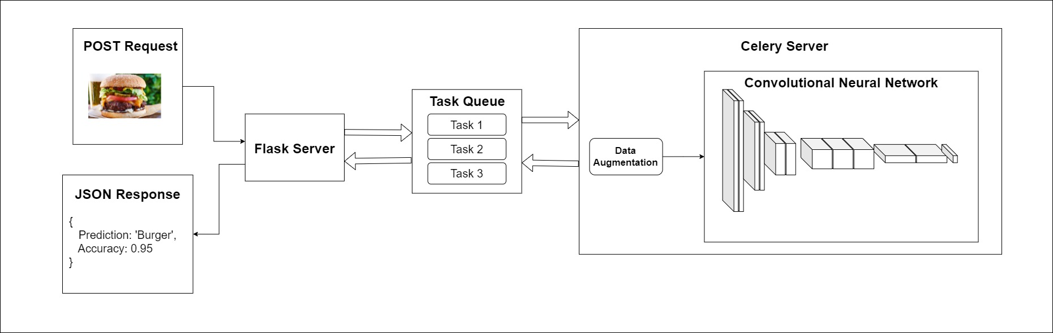
Back-end Design for ml model

Slide 8
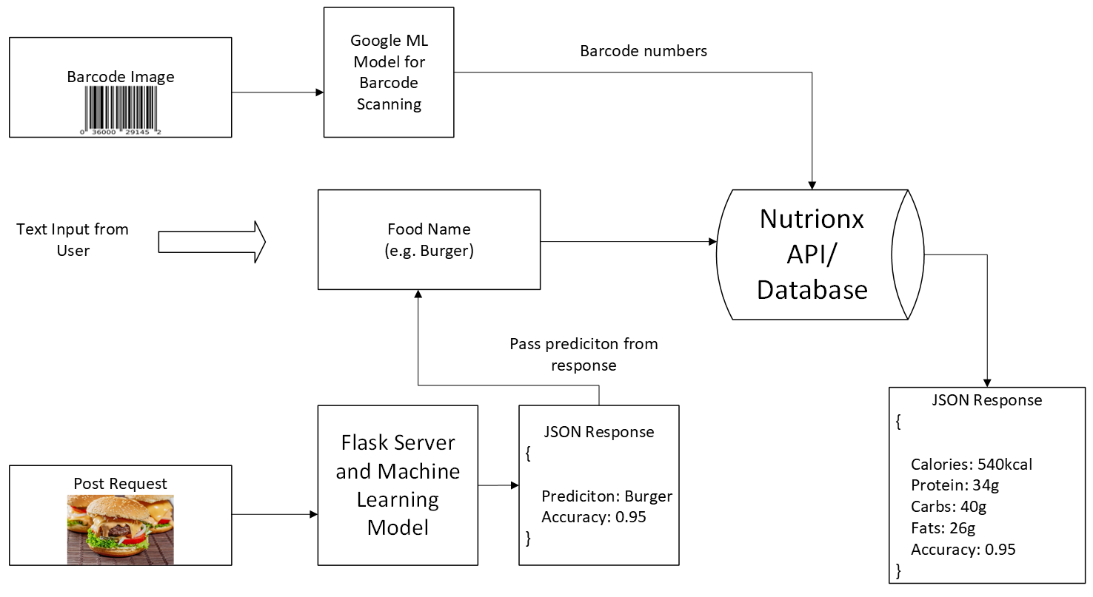
Back-end design for nutrition api

Slide 9
Back-end Consideration
Flask & Celery:
Allows Asynchronous predictions Both Static and Dynamic layouts
Light-weight compared to other Python frameworks such as Django
Better performance needed to process predictions
Minimal transactions between the database
More scalable and easier to deploy multiple instances due to a smaller size

